Slide 1
Machine Learning
Facilitator: Dr Amit Swamy
Group-9
Rohith 23WU0102103 Keerthan 23WU0102232
Jatin 23WU0102116
Akhil 23WU0102094
Muktesh 23WU0102157

Slide 2
Ranking
Report-1
“Ranking" commonly refers to extracting a scoring approach from statistics using algorithms.
The process of placing objects, entities, or pieces in a certain order to represent their relative significance, importance, or worth in a particular context is known as Ranking.

Slide 3
Product Aspect Ranking and Its Applications
Objective: A product aspect ranking framework presented in the paper helps identify vital product elements through consumer reviews to achieve better usability along with better knowledge retrieval.
Approach: The identification of key aspects depends on aspect frequency and opinion influence using dependency parsing, sentiment analysis, and probabilistic aspect ranking computations.
Results & Applications: The framework demonstrated its effectiveness through experimental results applied to 21 products spanning eight different domains. The framework demonstrates its practical benefits through improved document sentiment detection and review synthesis capabilities.

Slide 4
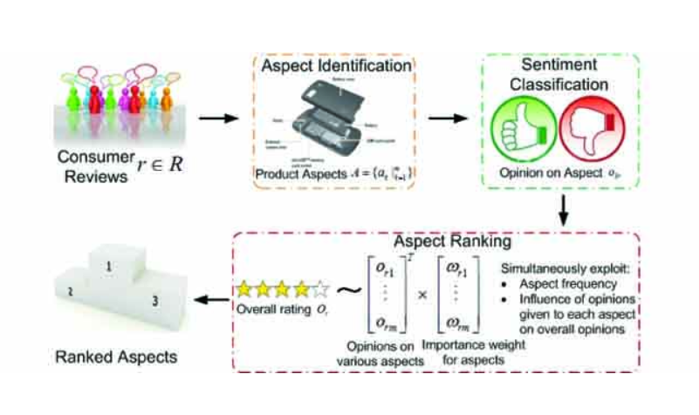

Slide 5
Clustering
The task of grouping data points based on their similarity is called Clustering or Cluster Analysis.
This method is defined under the branch of Unsupervised learning, which aims at gaining insights from Unlabelled data points, that is, unlike supervised learning we don’t have a target variable.

Slide 6
Validity-guided (re)clustering with applications to image segmentation
Objective: VGC presents a Validity-Guided (Re)Clustering (VGC) algorithm that enhances image segmentation through cluster-validity assessments to overcome clustering algorithm constraints.
Approach: VGC uses an iterative split-and-merge process to enhance the initial fuzzy clustering partition while keeping modifications that enhance partition validity.
Results & Applications: The VGC algorithm shows superior results over fuzzy c-means in synthetic and real-world data applications specifically MRI segmentation where it matches the effectiveness of supervised k-nearest-neighbors according to radiological validation.
.

Slide 7
Dimensionality Reduction
The number of input features, variables, or columns present in a given dataset is known as dimensionality, and the process to reduce these features is called dimensionality reduction.
A dataset contains a huge number of input features in various cases, which makes the predictive modeling task more complicated.
It is very difficult to visualize or make predictions for the training dataset with a high number of features, for such cases, dimensionality reduction techniques are required.

Slide 8
Performance Evaluation of Dimensionality Reduction Techniques on High-Dimensional Data
Objective: This paper analyzes three common dimension reduction techniques: Independent Component Analysis (ICA) alongside Principal Component Analysis (PCA) and Non-Negative Matrix Factorization (NMF) as solutions to handle high-dimensional datasets.
Approach: This research applies standardized benchmarks to check real-world datasets to measure the performance efficiency and effectiveness of the method.
Conclusion: Data scientists gain direction from this study regarding which dimensionality reduction method to choose by considering effectiveness alongside computational efficiency.

Slide 9
Citations
Zha, Z.-J., Yu, J., Tang, J., Wang, M., & Chua, T.-S. (2014). Product aspect ranking and its applications. IEEE Transactions on Knowledge and Data Engineering, 26(5), 1211-1224. https://doi.org/10.1109/TKDE.2013.136
Bensaid, A. M., et al. (1996). Validity-guided (re)clustering with applications to image segmentation. IEEE Transactions on Fuzzy Systems, 4(2), 112-123. https://doi.org/10.1109/91.493905
Vikram, M., Pavan, R., Dineshbhai, N. D., & Mohan, B. (2019). Performance evaluation of dimensionality reduction techniques on high dimensional data. In 2019 3rd International Conference on Trends in Electronics and Informatics (ICOEI) (pp. 1169-1174). IEEE. https://doi.org/10.1109/ICOEI.2019.8862526

Slide 10
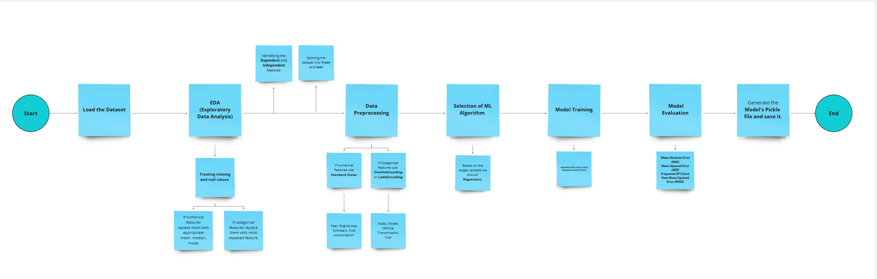
Report-2
Flowchart for the solution
Task-2
Dataset-2 (Predicting fuel consumption based on vehicle features)

Slide 11
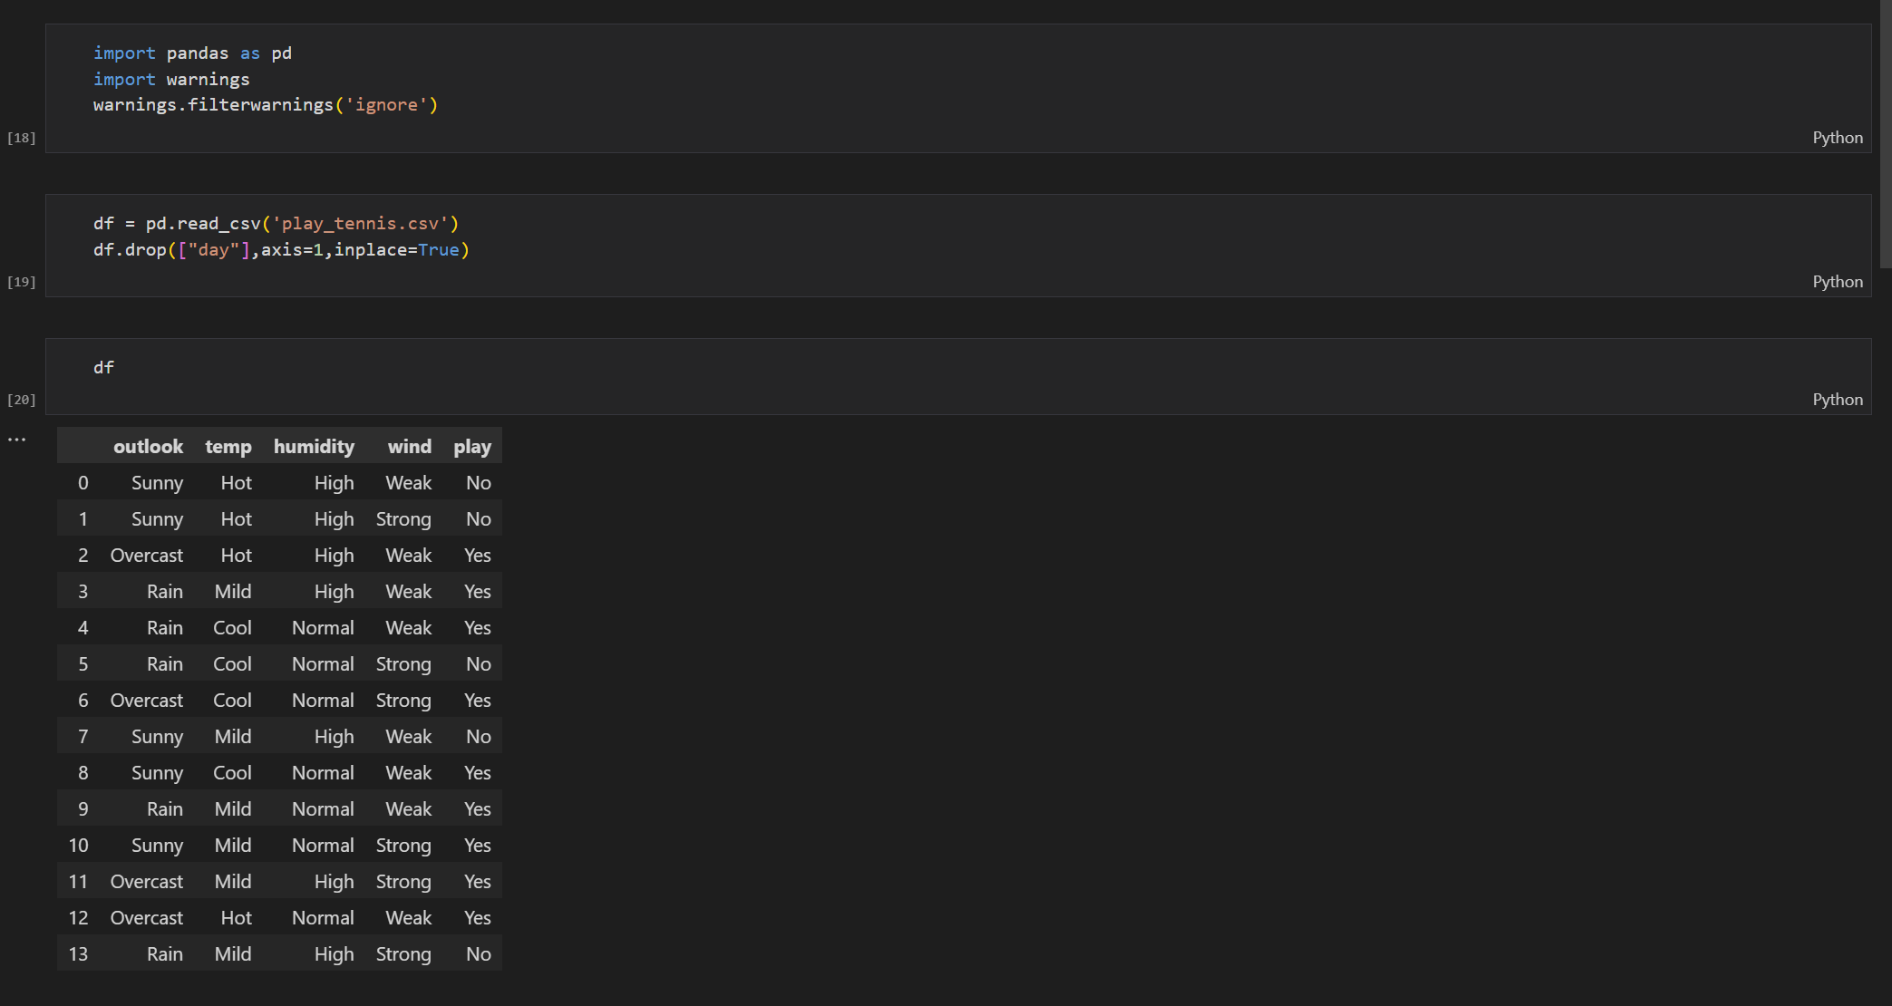
Report-3
Task-3
Competition

Slide 12
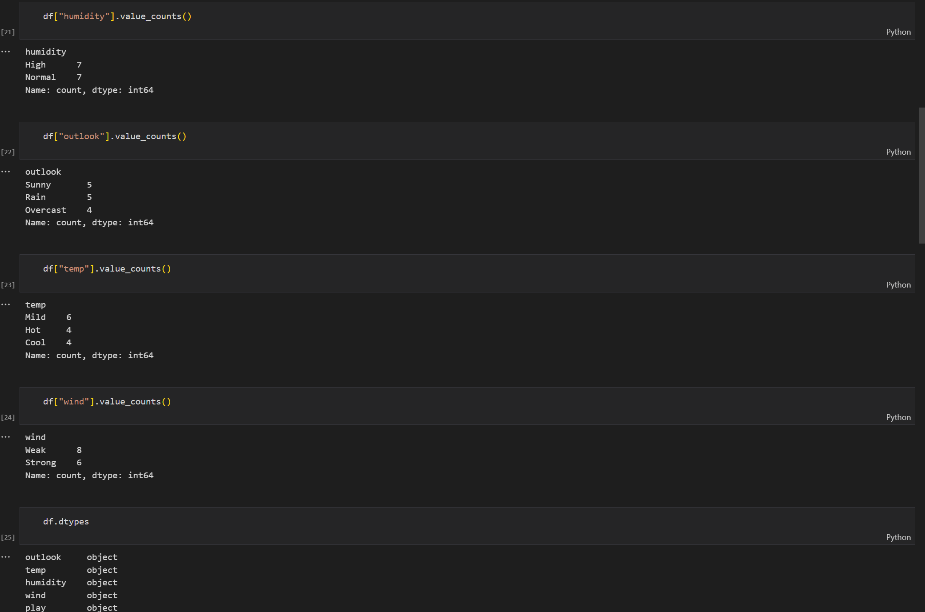
Report-3
Task-3
Competition

Slide 13
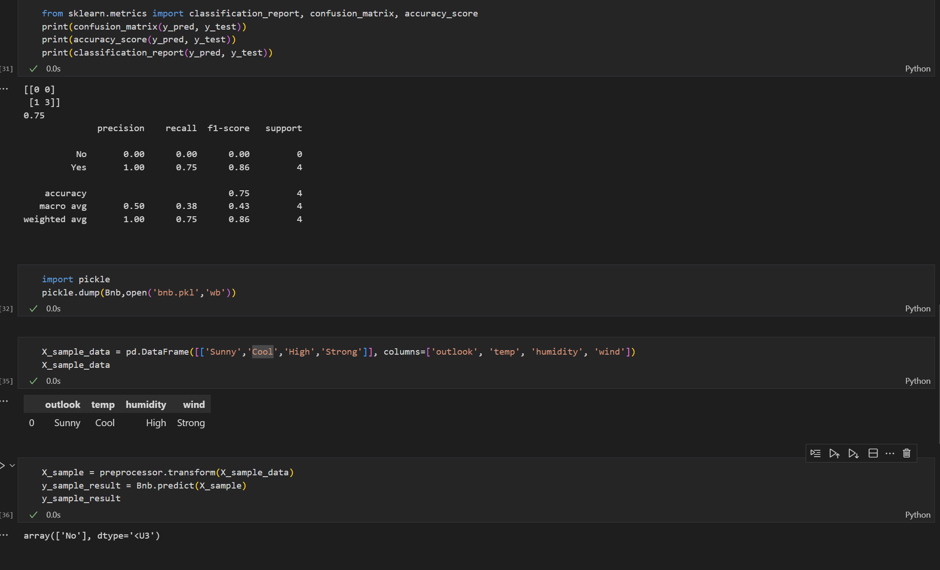
Report-3
Task-3
Competition

Slide 14
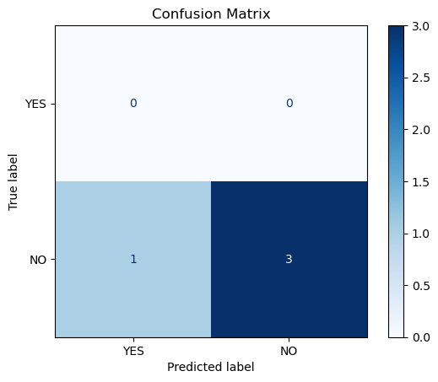
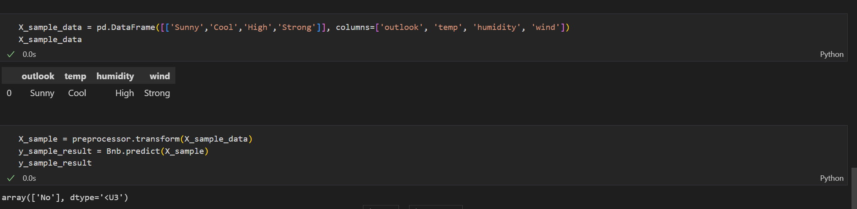
Report-3
Task-3
Competition
Accuracy: 75%
Output:

Slide 15
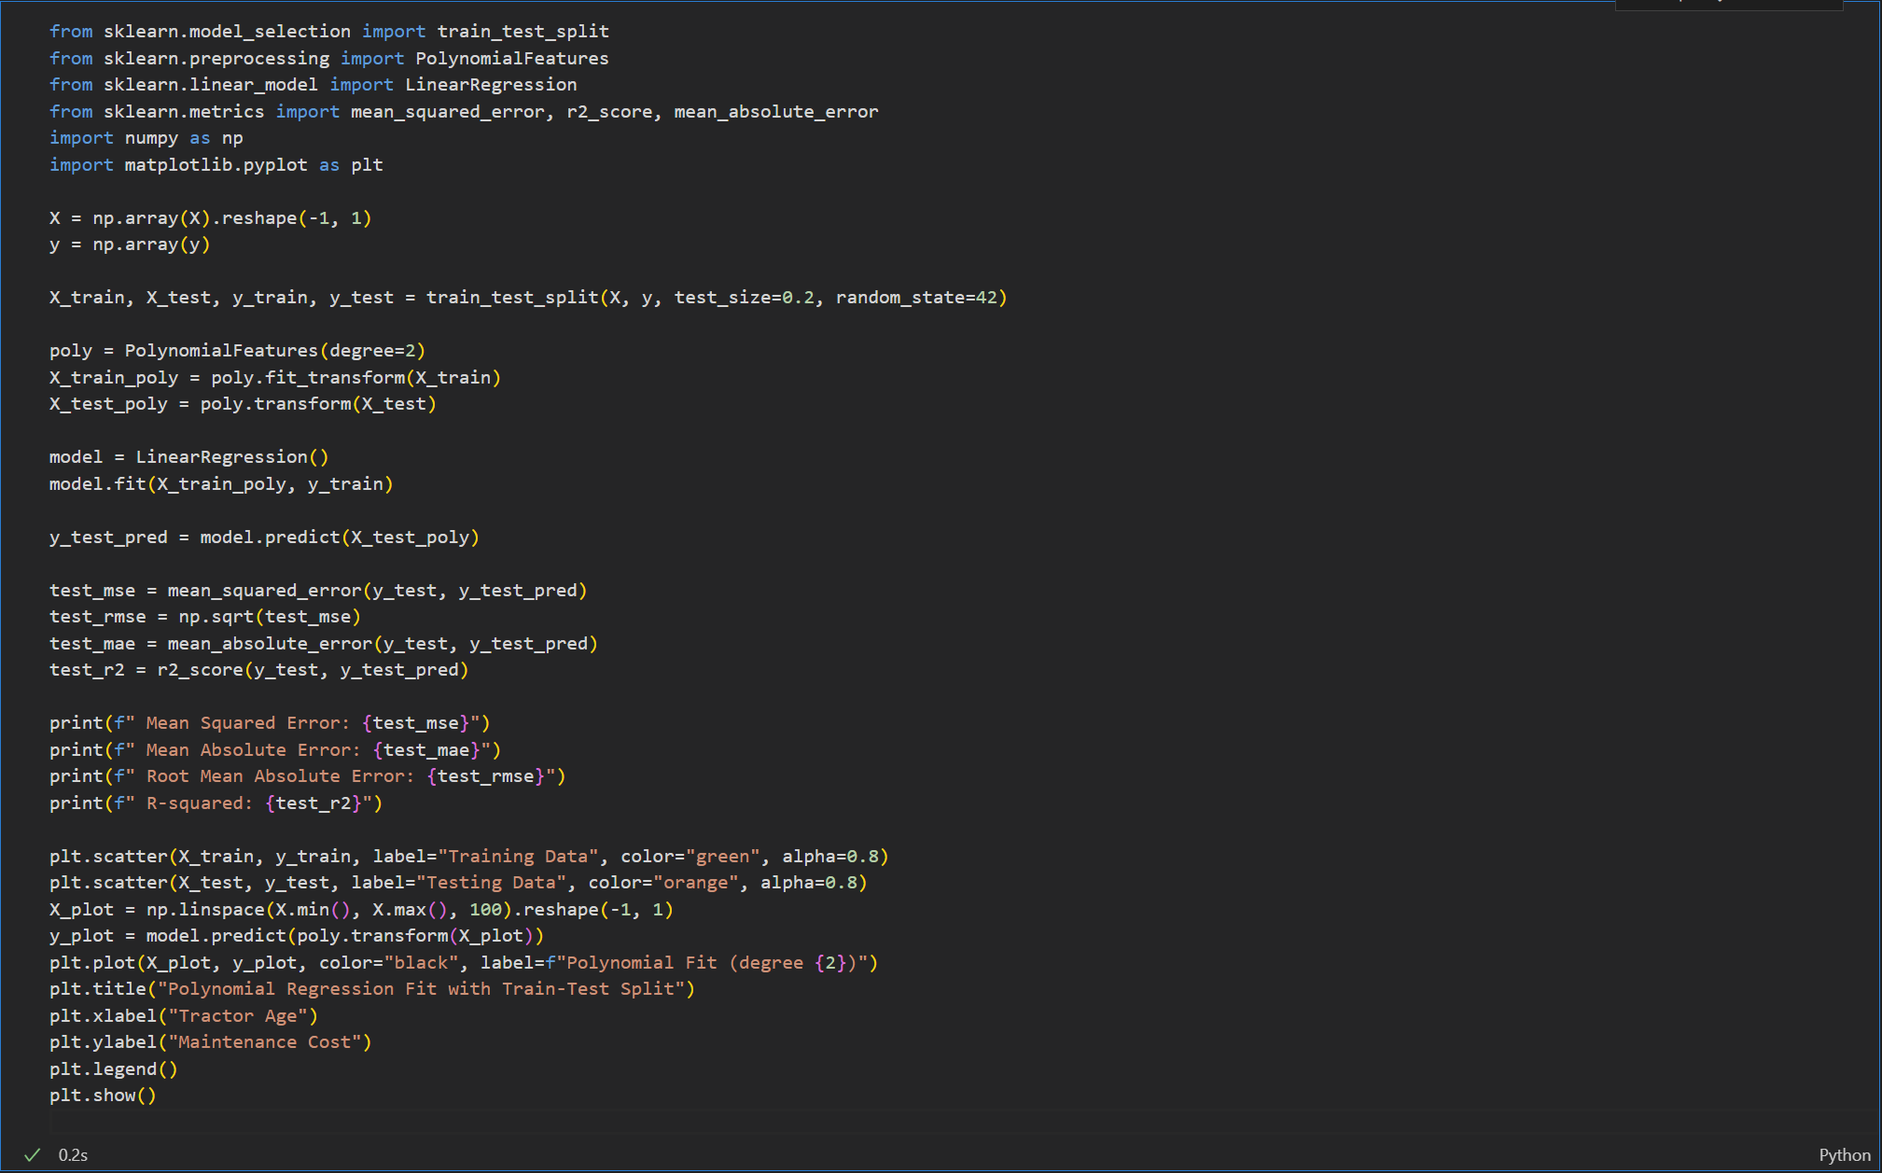
Report-4
Task-4
Competition Goal

Slide 16
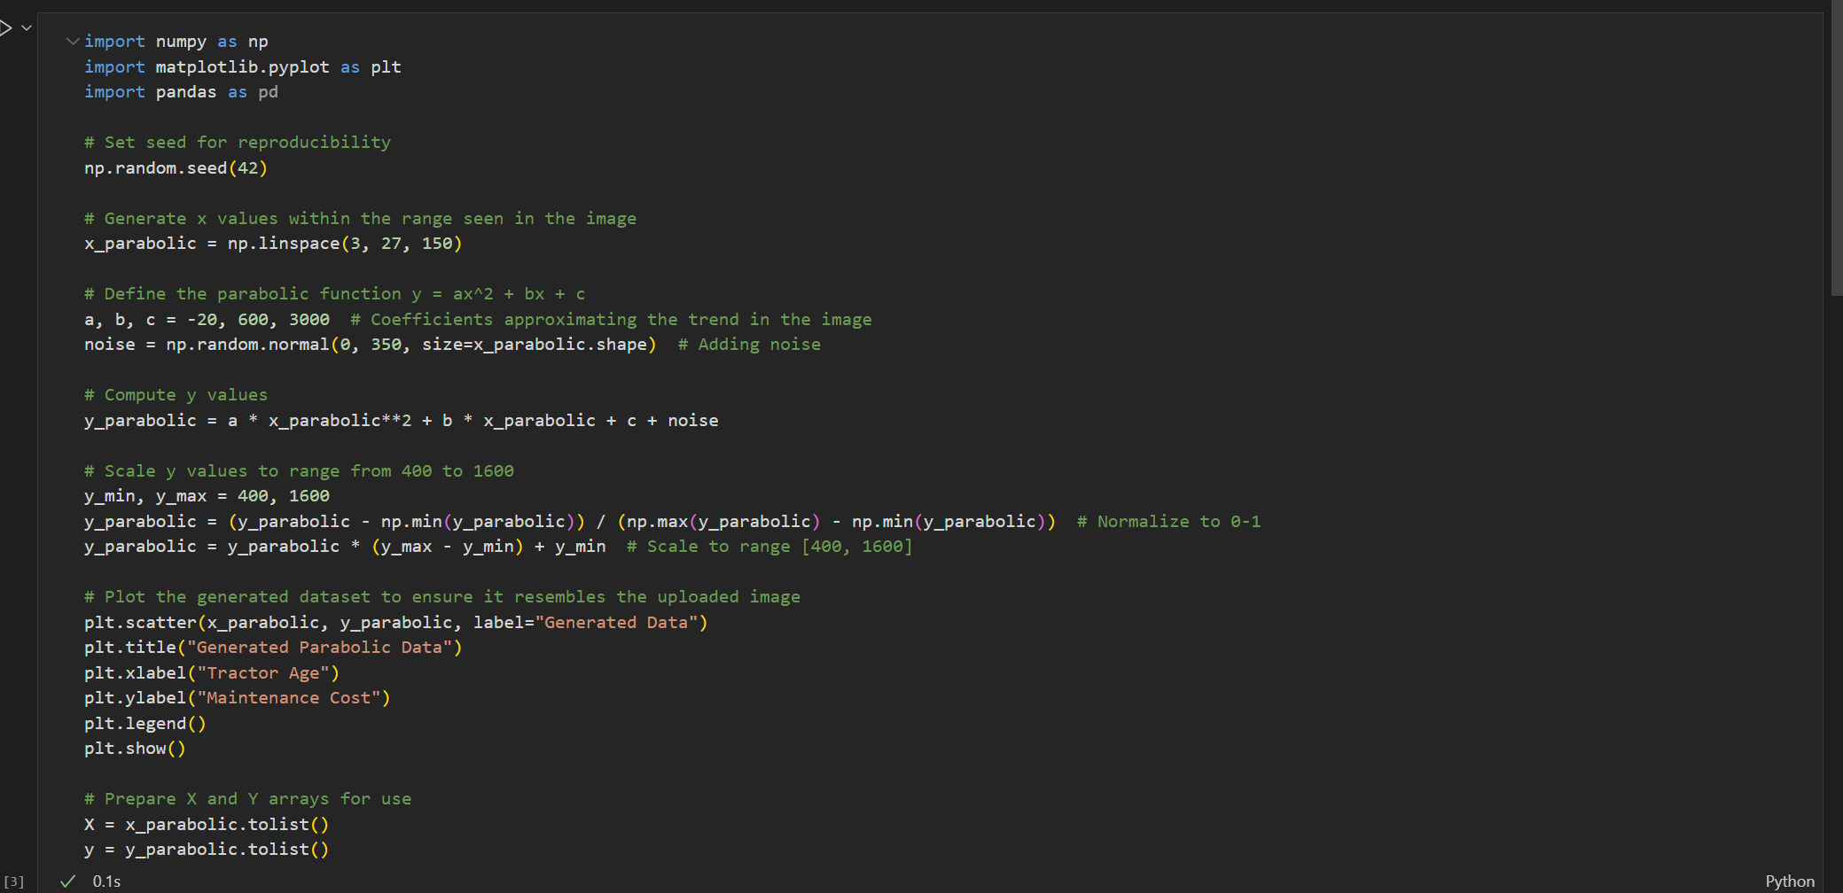
Report-4
Task-4
Competition Goal

Slide 17
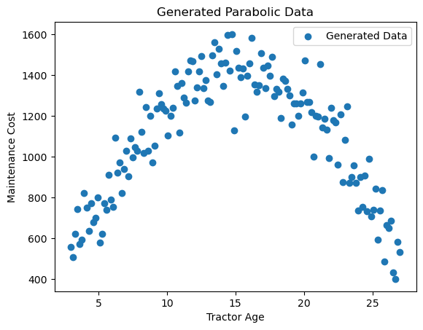
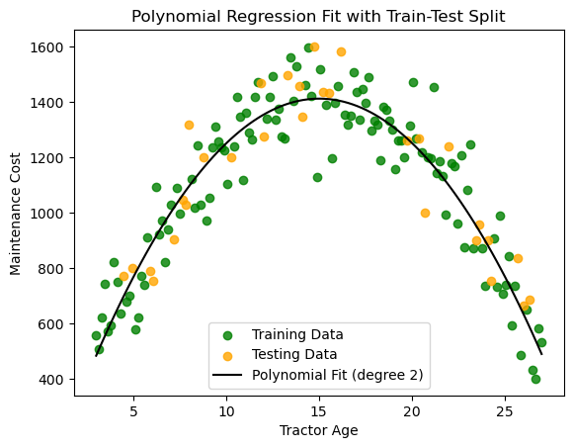
Report-4
Task-4
Competition Goal
Results:-
Mean Squared Error: 10937.089362129414
Mean Absolute Error: 85.77776295657462
Root Mean Absolute Error: 104.58054007380825
R-squared: 0.8674798174597006

